Slide 1
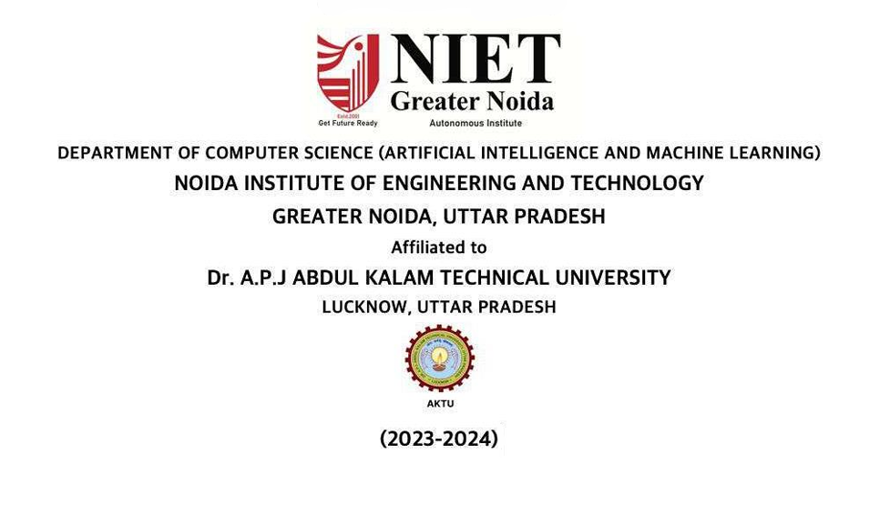

Slide 2


Introduction to Anime Image Generation
Anime, the distinctive Japanese animation style, has captivated audiences worldwide with its vibrant characters, imaginative worlds, and unique aesthetic. This presentation explores the exciting field of generating high-quality anime-style images using Generative Adversarial Networks (GANs), a powerful deep learning technique that can create novel, realistic-looking anime art.
by -Kartik Khandelwal(TL)
-Pawan Kumar
-Rishabh Dev Parashar
-Tarun Kumar Singh

Slide 3
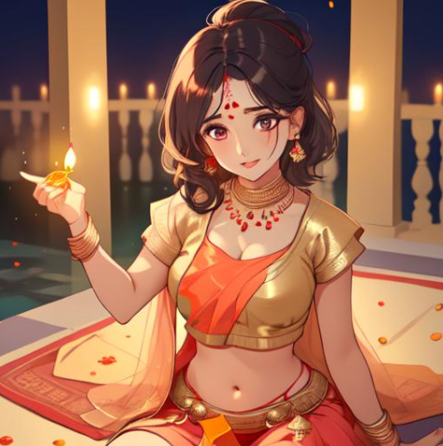
Fundamentals of Generative Adversarial Networks (GANs)
Generative Adversarial Networks (GANs): A powerful deep learning framework that pits two neural networks against each other to generate realistic, synthetic data.
Discriminator Network: Learns to differentiate between real and fake data, providing feedback to the Generator Network.
Generator Network: Learns to create realistic, synthetic data that can fool the Discriminator Network, leading to an adversarial training process.

Slide 4

Architectural Considerations for Anime GAN Models
Designing effective Anime GAN models requires careful architectural choices to capture the unique visual style and features of anime art. Key considerations include network depth, skip connections, attention mechanisms, and generative model architectures tailored for anime-specific characteristics.
Stable and high-quality anime image generation also demands specialized loss functions, regularization techniques, and advanced training strategies to overcome common challenges such as mode collapse and lack of diversity.

Slide 5
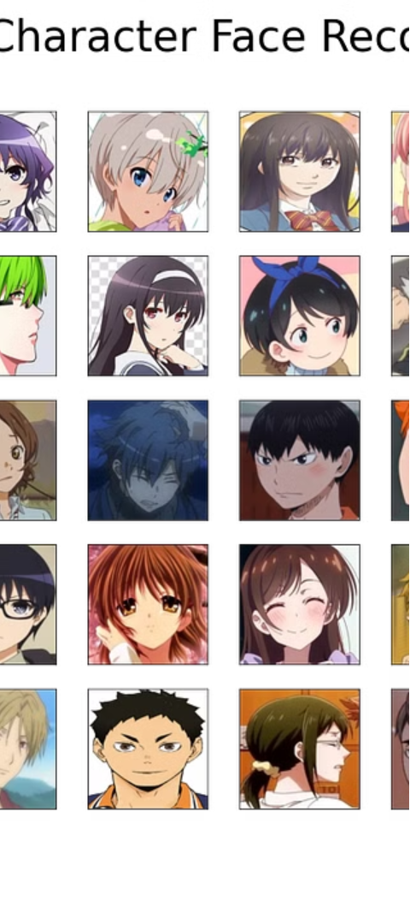
Dataset Preparation and Preprocessing
1
Data Collection
Gather a diverse dataset of high-quality anime images from various online sources, ensuring a wide range of styles, characters, and scenes are represented.
2
Data Preprocessing
Clean and preprocess the collected images by resizing, cropping, and normalizing them to a consistent format. Remove any low-quality or irrelevant images.
3
Data Augmentation
Apply techniques like flipping, rotating, Captioning the image using VGG16 and color jittering to artificially expand the dataset, adding more diversity and improving model generalization.

Slide 6
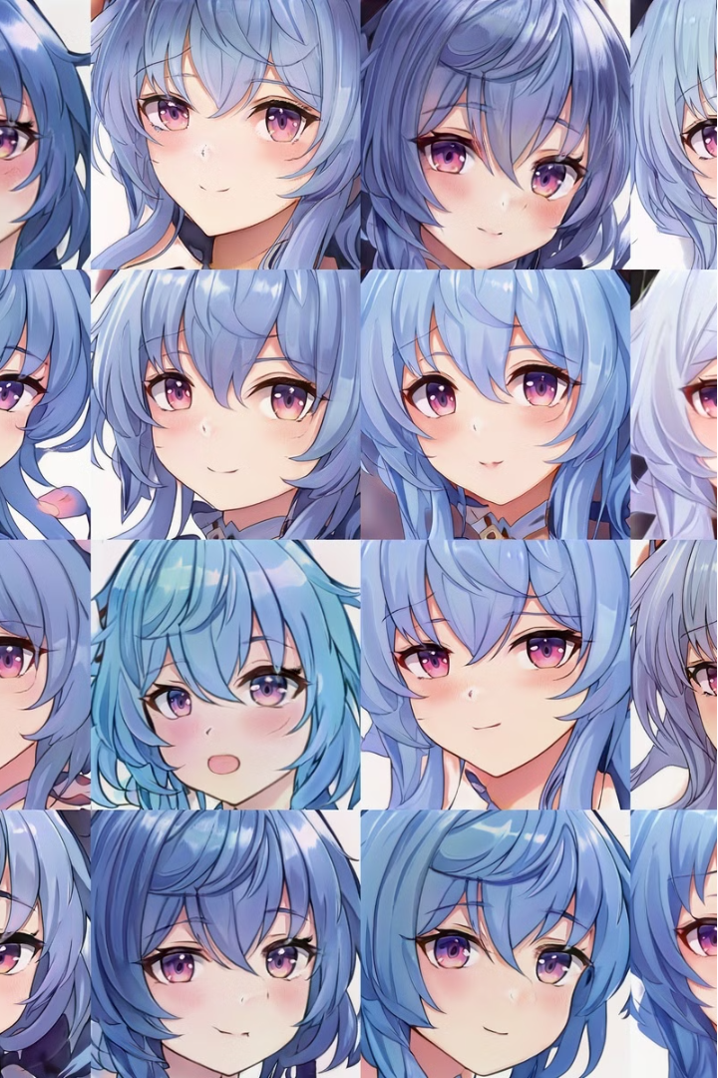
Training Anime GAN Models
The training process for Anime GAN models involves a delicate balance between the Generator and Discriminator networks. Careful hyperparameter tuning, such as learning rates, batch sizes, and optimization algorithms, is crucial to achieve stable and convergent training.
Techniques like gradient penalty, spectral normalization, and mini-batch discrimination can help mitigate common GAN challenges, such as mode collapse and vanishing gradients, leading to higher-quality and more diverse anime image generation.

Slide 7
Evaluation and Metrics for Anime Image Generation
Quantitative Evaluation
Human Evaluation
Anime-Specific Metrics
Benchmark Datasets
Utilize objective metrics like Inception Score, Fréchet Inception Distance, and Perceptual Similarity to assess the quality, diversity, and realism of the generated anime images.
Conduct user studies with anime art enthusiasts to get their subjective assessments on factors like character design, background aesthetics, and overall artistic merit.
Leverage established anime image datasets, like the Danbooru2018 corpus, to compare the performance of your Anime GAN model against other state-of-the-art approaches.
Develop customized evaluation metrics that capture the unique visual characteristics of anime, such as exaggerated facial features, vibrant color palettes, and stylized backgrounds.

Slide 8
Techniques for Enhancing Anime GAN Performance
1
Architecture Refinement
2
Discriminator Improvements
Explore novel neural network architectures designed specifically for anime image generation, incorporating techniques like self-attention, progressive growing, and multi-scale generation.
Enhance the Discriminator network with specialized modules to better capture the nuanced visual characteristics of anime art, such as facial features, clothing styles, and background details.
3
Latent Space Manipulation
4
Adaptive Training
Implement adaptive training strategies that dynamically adjust hyperparameters and loss functions based on the current state of the Generator and Discriminator, improving convergence and stability.
Develop methods to intelligently navigate the latent space of the Generator, allowing for fine-grained control over the generated anime images and their attributes.

Slide 9

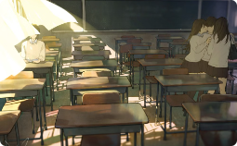
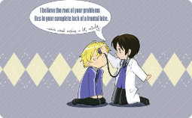
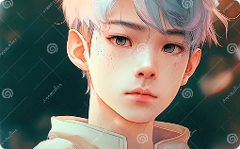
Potential Applications and Future Directions
Commercial Applications
Educational Tools
Medical Visualization
Generative Art
Anime-style GAN models can be leveraged to generate visuals for a wide range of commercial applications, from video games and animated films to product design and advertising.
Anime GAN models can be used to create interactive educational content and learning materials, making complex topics more engaging and accessible for students.
Anime-inspired GAN models can be employed to generate captivating visualizations of medical data and anatomical structures, enhancing the understanding of complex biological systems.
The unique creative potential of Anime GANs can inspire a new era of generative art, where artists collaborate with AI to produce visually stunning and imaginative anime-style artwork.

Slide 10
Code
GAN Implementation
Custom Layers and Optimizations
Implement the core Generative Adversarial Network (GAN) architecture, including the Generator and Discriminator models, loss functions, and training loop.
Develop specialized neural network layers and training techniques tailored for high-quality anime image generation, such as self-attention mechanisms and progressive growing.
Developer Tools and Libraries
Deployment and Inference
Leverage open-source deep learning frameworks like PyTorch or TensorFlow to build the StyleGAN model and take advantage of their rich ecosystem of pre-built components.
Package the trained Anime GAN model for seamless deployment, enabling real-time inference and generation of new anime-style images.

Slide 11
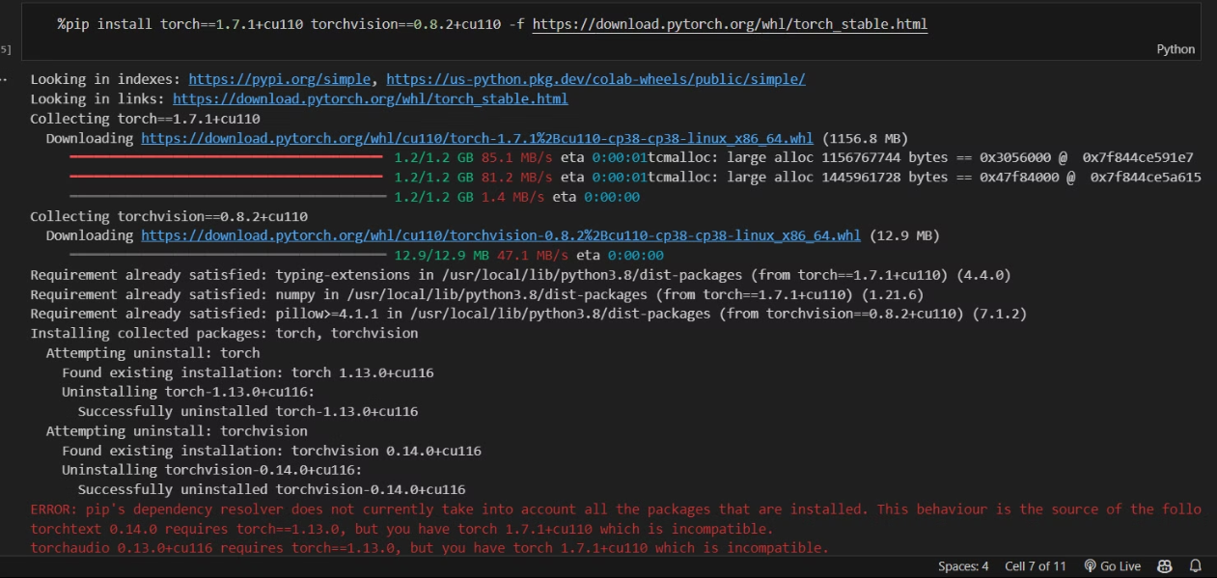
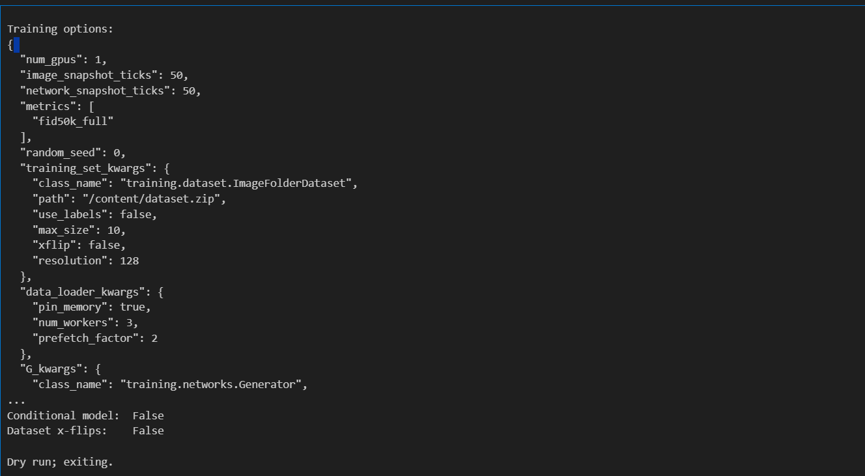

Slide 12
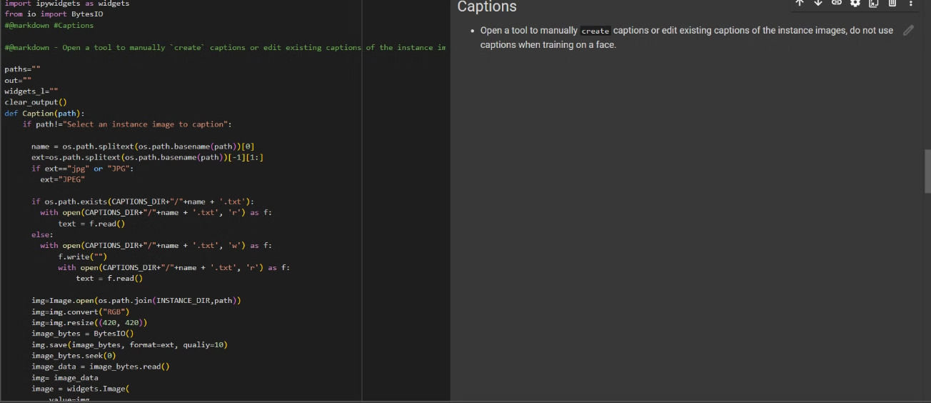
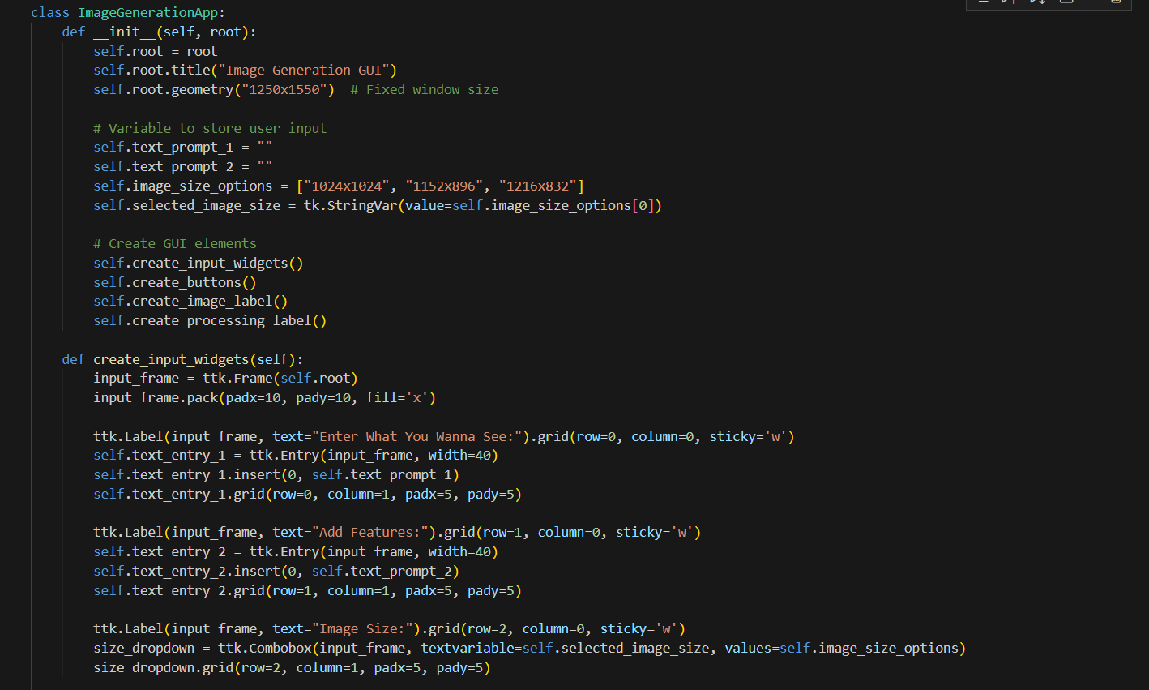

Slide 13
